Slide 1
Day 2

Slide 2
Part I
Introduction to Time Series Analysis

Slide 3
What and Why Time Series Analysis is essential?
Time series (TS) is collection of data in a sequential and uniformly interval manner over time. It can be various data but must be time dependent.
Example of TS data including stock prices, energy production, house prices, weather forecast and so on.
Time series data is crucial to predict what will happen in the future especially in business and socio economics since that these conditions are constantly changing over time.
Data analysts must be able to capture and assess and predict the effects of these changes, in order to suggest the most appropriate actions to take.

Slide 4
Applications of TS Analysis
Stock & Market Prices
predict future prices
Logistic & Transportation
Forecasting of shipped packages: workforce planning
Retail Grocery
Forecasting of sales during promotions: optimizing warehouses
Insurance
Claims prediction: determining insurance policies
Manufacturing
Predictive Maintenance: improving operational efficiency
Energy & Utilities
Energy load forecasting: better planning and trading strategies

Slide 5
TS data vs. Cross Sectional data
A Time series is made up by dynamic data collected over time. Consider the differences between:
Cross Sectional Data - Multiple objects observed at a particular point of time.
Examples: customers’ behavioral data at today’s update, companies’ account balances at the end of the last year, patients’ medical records at the end of the current month etc.
Time Series Data - One single object (product, country, sensor, ..) observed over multiple equally-spaced time periods
Examples: quarterly Italian GDP of the last 10 years, weekly supermarket sales of the previous year, yesterday’s hourly temperature measurements etc.

Slide 6
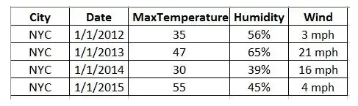
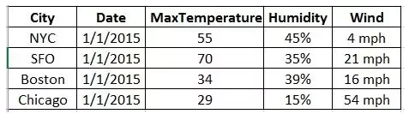
Can you distinguish the difference?
Time Series Data
Cross-sectional Data
Notes:
Additional info (Panel data - combination of both TS and cross-sectional data)

Slide 7
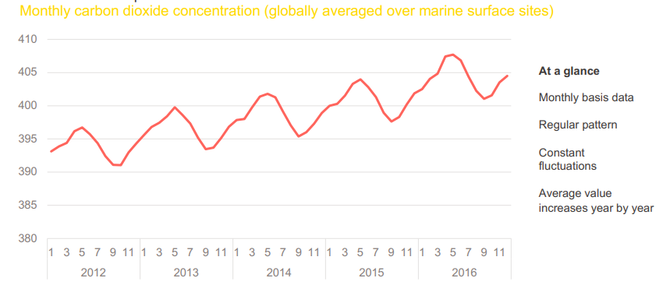
Example of TS Data

Slide 8
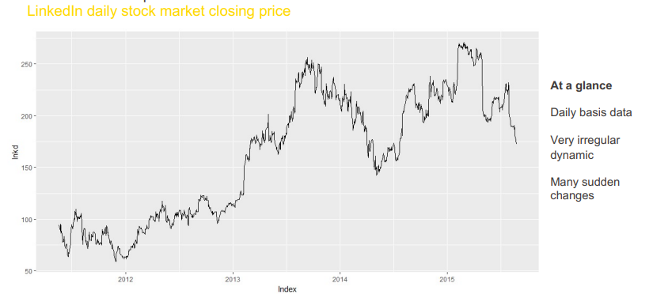
Example of TS Data

Slide 9
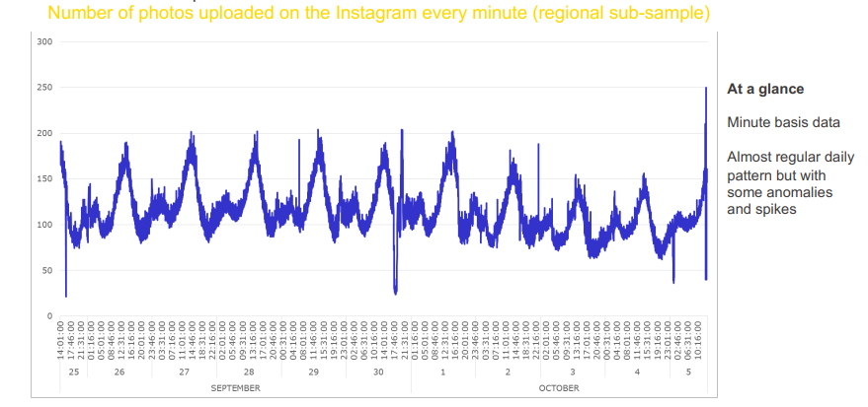
Example of TS Data

Slide 10
Time-series crucial components
Trend:
Time-series data shows a trend when its value variably changes with time, an increasing value shows a positive trend and decreasing, a negative trend. In the figure below, you can see a positive increasing trend.
Seasonality:
Seasonality refers to a property of time-series that displays periodical patterns repeating at a constant frequency. In the example above, we can observe a seasonal component with the frequency being 12 months, which broadly means that the periodical pattern repeats every twelve months.
Remainder:
After extracting Trend and Seasonality from the data, the remaining is what we call remainder (error) or Residual. This actually helps in anomaly detection in time-series.
Cycle:
Time-series data is termed cyclical when there are trends with no set repetitions or seasonality.
Stationarity:
Time-series data is stationary when its statistical features do not change over time i.e. a constant mean and standard deviation. The covariance is independent of time.

Slide 11
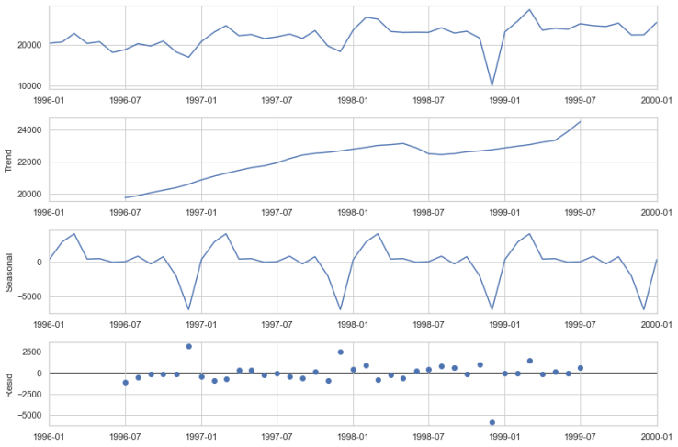
Time-series components
Notes:
https://neptune.ai/blog/time-series-prediction-vs-machine-learning

Slide 12
Time Series Data - Types
Univariate time series
Only the history of one variable is collected as input for the analysis. For example, only the temperature data collected over time from a sensor measuring the temperature of a room every second.
Bivariate time series
This type of data involves two different variables. The analysis of this type of data deals with causes and relationships and the analysis is done to find out the relationship among the two variables.Example of bivariate data can be temperature and ice cream sales in summer season.
Multivariate time series
The history of multiple variables is collected as input for the analysis. For example, in a tri-axial accelerometer, three accelerations are measured over time, one for each axis (x,y,z).
Notes:
https://www.knime.com/blog/multivariate-time-series-analysis-lstm-codeless
https://www.geeksforgeeks.org/univariate-bivariate-and-multivariate-data-and-its-analysis/

Slide 13
Available Methods for TSA & Forecasting
Traditional Method such as using ARIMA, SARIMA Model and so on
Machine Learning Method such as Regression, Random Forest, XGBoost and so on.
Deep learning approach:
Multilayer Perceptron (MLPs)
Convolutional Neural Network (CNN)
Recurrent Neural Network (RNN) - using LSTM
Hybrid (combination of other types of model algorithm)

Slide 14
The Traditional TSA and Forecasting - Process Flow
Identifying components in the Dataset
Understand and identify the case study.
05
Forecasting ARIMA Model
01
04
Pre-work for AR/MA
Check Stationarity of the Data
In traditional method, we need to check the stationarity of the data
02
03
Convert non-stationary data to stationary

Slide 15
Machine Learning for TSA
Notes:
Explain a little bit about ML for time series

Slide 16
Why Use Deep Learning for Time Series Forecasting?
One of the main reason why Deep Learning has become popular for Time Series forecasting is due to its ability to learn arbitrary complex mapping from inputs to outputs.
Traditional method of Time Series forecasting (ARIMA etc), require stationary and linear input.
Deep learning approach does not require stationary input (although you can implement one). The data undergo EDA, then transform to 3-Dimensional array and straightway feed to the model for training.

Slide 17
Approach | Advantages | Disadvantages
Traditional & ML Method | Widely used and well understood Do not require very large data Not computationally expensive | Require linear and stationary input data Focus on fixed temporal dependence Focus on univariate data Focus on one-step forecasts
Deep Learning Method | Doesn’t require scaled or stationary time series as input ability to learn arbitrary mapping functions support multivariate inputs support multi-step outputs | Computational Expensive Require big data

Slide 18
Important Key Takeaways…
There are many methods can be applied in TSA which include:-
Traditional Method
ML Method
Deep Learning Method
Deep Learning has been emerging lately to solve time series analysis as it has ability to learn arbitrary complex mapping from inputs to outputs, support multivariate time series analysis and doesn’t require to convert data to stationary input

Slide 19
Part II
The Fundamental of
Deep Learning

Slide 20
Artificial Neural Network (ANN)
Artificial Neural Network (ANN) is built by imitating Human Biological Neural Network
Similarly in human brain that has neurons interconnected to one another, artificial neural networks also have neurons that are interconnected to one another in various layers of the networks. These neurons are known as nodes.
For learning to take place, the ANN need to be trained first. The training is performed using a defined set of rules, also known as the learning algorithm.
The neural network learns by adjusting its weights and bias (threshold) iteratively to yield the desired output. (this is called parameters). Initially, you have to set the hyperparameters before you train your neural network

Slide 21
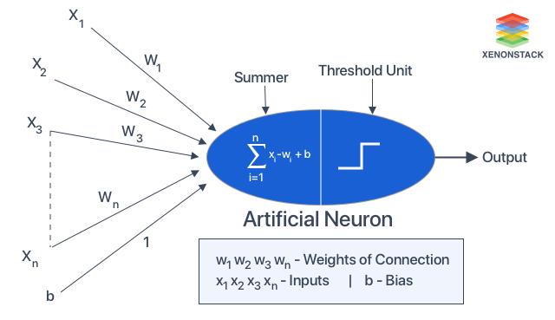
How Artificial Neural Network work?
The Activation function
The activation function refers to the set of transfer functions used to achieve the desired output.
The Activation function is the one that allow if the output should be fire or not. If it’s activated the output will be fired and vice versa.

Slide 22
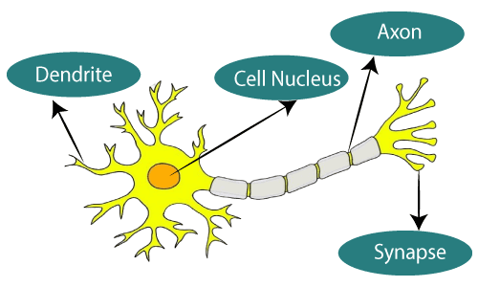
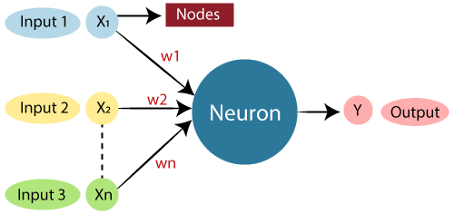
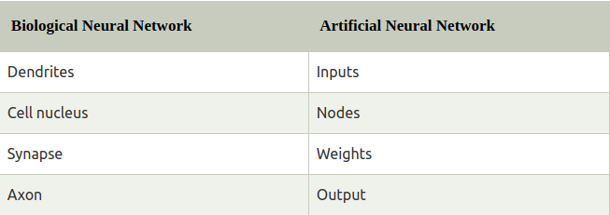
This is where the information comes from
It’s where the sum of inputs*weights take places
The point of interconnection of one neuron with other neurons.
The results are transmitting through here

Slide 23
Model Parameters and Hyperparameters
A model parameter is a configuration variable that is internal to the model and whose value can be estimated from data. Example of Model Parameters:
The coefficients (or weights) of linear and logistic regression models.
Weights and biases of a Neural Network
The cluster centroids in clustering
Hyperparameters are parameters that are explicitly defined by the user to control the learning process & usually configure at the beginning before the model training. Examples are:
Number of Layers
Number of Nodes
Optimizers such as Adam and so on
Learning rate of the Optimizer
Batch size
Number of epochs
To simplified, parameters in machine learning and deep learning are the values your learning algorithm can change independently as it learns and these values are affected by the choice of hyperparameters you provide

Slide 24
Learning Strategy in Artificial Neural Network
Training a neural network requires strategy in order to obtain minimal loss as much as possible. There are two ways we can achieve this by:-
Monitoring the Loss index
provides a measure of the quality of the representation required to learn. The choice of a suitable loss index depends on the application.
Selection Optimization algorithm (a.k.a learning algorithm)
The optimization algorithm determines how the adjustment of the parameters in the neural network takes place.

Slide 25
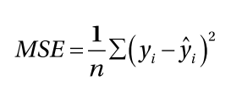
Model Evaluation Metrics - MSE
The mean squared error calculates the average squared error between the outputs from the neural network and the targets in the data set.
Mean Square Error (MSE) described as in formula below:
Where:
n = represent the total number of values in test sets
yi = Actual value
y’i = Predicted value
The closer MSE to zero is the better.
Notes:
Useful reading link:
https://analyticsindiamag.com/a-guide-to-different-evaluation-metrics-for-time-series-forecasting-models/

Slide 26
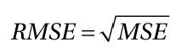
Model Evaluation Metrics - RMSE
Root Mean Squared Error (RMSE)
The closer of RMSE to zero the better.

Slide 27
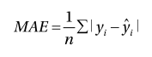
Model Evaluation Metrics - MAE
Mean Absolute Error (MAE)
The lower the MAE value, the better the model; a value of zero indicates that the forecast is error-free.
The model with the lowest MAE is deemed superior when comparing many models.

Slide 28
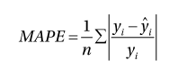
Model Evaluation Metrics - MAPE
Mean Absolute Percentage Error (MAPE)
The model is better if the MAPE is low. MAPE works best with data that is devoid of zeros and extreme values. MAPE, like MAE, understates the impact of big but rare errors caused by extreme values.

Slide 29
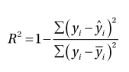
Model Evaluation Metrics - R2
R squared is a performance metric rather than an error metric.
R2 is a value that tends to be between 0 to 1, with 0 is bad and 1 is perfect.

Slide 30
Optimization algorithm (Optimizers)
Optimizers are algorithms or methods used to change the attributes of the neural network such as weights and learning rate to reduce the losses. Optimizers are used to solve optimization problems by minimizing the function.
Types of optimizers:-
Gradient Descent - the grandfather of all optimizers
Stochastic Gradient Descent (SGD)
Mini Batch Stochastic Gradient Descent (MB-SGD)
SGD with momentum
Nesterov Accelerated Gradient (NAG)
Adaptive Gradient (AdaGrad)
AdaDelta
RMSprop
Adam - the most used optimizers
Notes:
https://www.kdnuggets.com/2020/12/optimization-algorithms-neural-networks.html

Slide 31
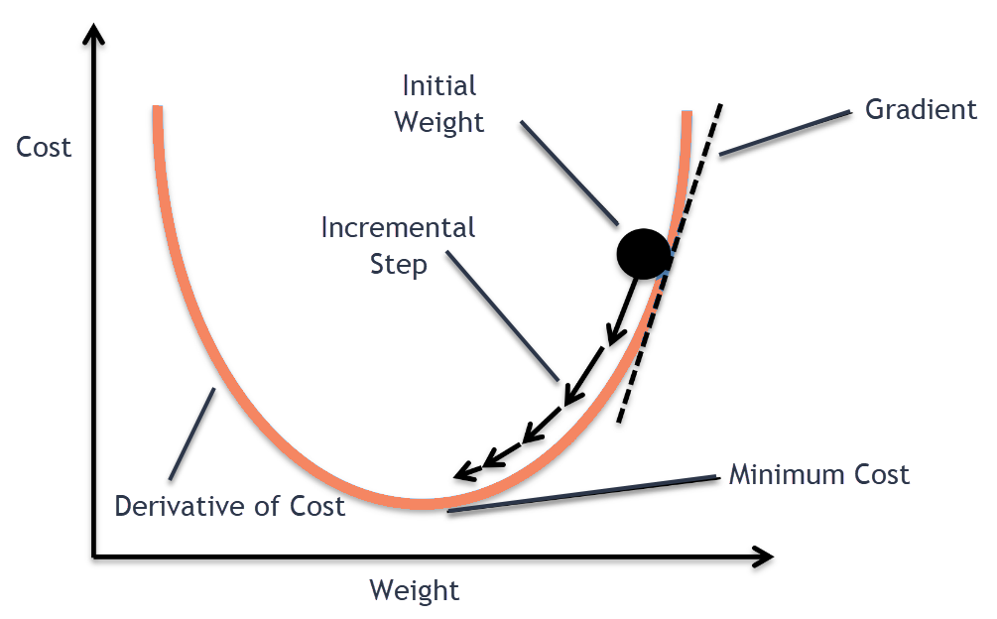
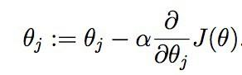
Gradient Descent
Gradient Descent is an optimization algorithm for finding a local minimum of a differentiable function. Gradient descent is simply used to find the values of a function's parameters (coefficients) that minimize a cost function as far as possible.
The algorithm works by:-
Calculate what a small change in each individual weight would do to the loss function.
Adjust each individual weight based on its gradient.
Keep doing steps 1 and 2 until the loss function gets as low as possible
Gradient descent equation,
Where:
theta(j) is the parameter at the correspond
Alpha is the learning rate
Our goal
Image Source

Slide 32
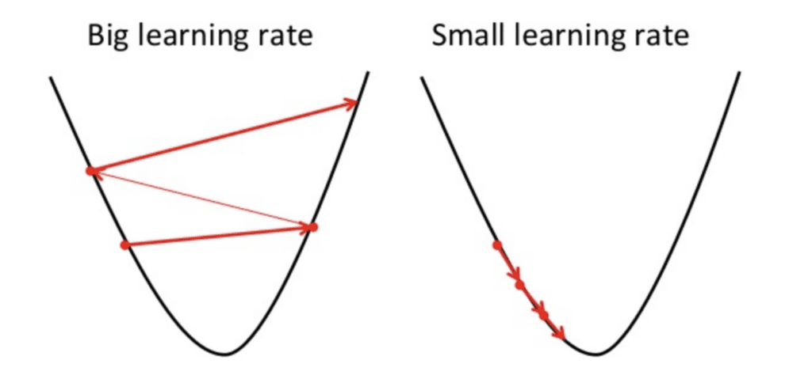
Gradient Descent - Learning rate
In Gradient Descent, the learning rate should not be too high or too low. See figure below.
If the steps it takes are too big, it may not reach the local minimum because it bounces back and forth between the convex function of gradient descent
Similarly if the learning rate is too small gradient descent will eventually reach the local minimum but that may take a while
Disadvantages:
May trap at local minima.
Weights are changed after calculating the gradient on the whole dataset. So, if the dataset is too large then this may take years to converge to the minima.
Requires large memory to calculate the gradient on the whole dataset.

Slide 33
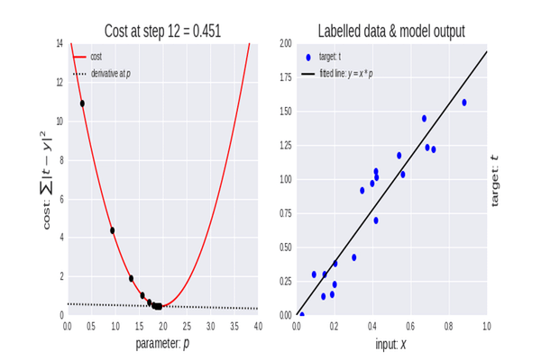

Slide 34
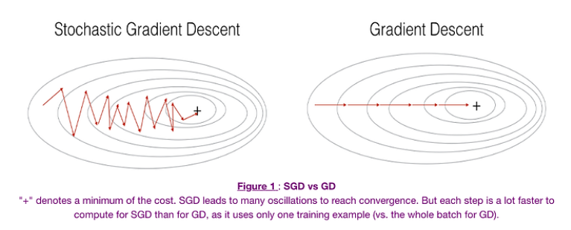
Stochastic Gradient Descent (SGD)
SGD algorithm is an extension of the Gradient Descent and it overcomes some of the disadvantages of the GD algorithm.
In the SGD algorithm derivative is computed taking one point at a time.
θ=θ−α⋅∇J(θ;x(i);y(i)) ,
where {x(i) ,y(i)} are the training examples

Slide 35
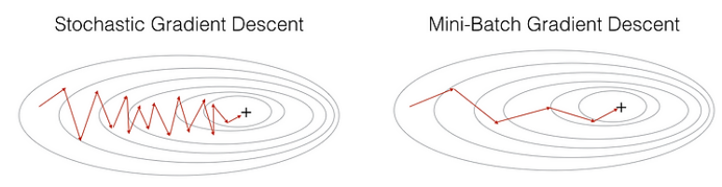
Mini Batch Stochastic Gradient Descent (MB-SGD)
MB-SGD algorithm is an extension of the SGD algorithm and it overcomes the problem of large time complexity in the case of the SGD algorithm.
MB-SGD algorithm takes a batch of points or subset of points from the dataset to compute derivates
θ=θ−α⋅∇J(θ; B(i)),
where {B(i)} are the batches of training examples.

Slide 36
ADAM
Adam (Adaptive Moment Estimation) works with momentums of first and second order. The intuition behind the Adam is that we don’t want to roll so fast just because we can jump over the minimum, we want to decrease the velocity a little bit for a careful search.

Slide 37
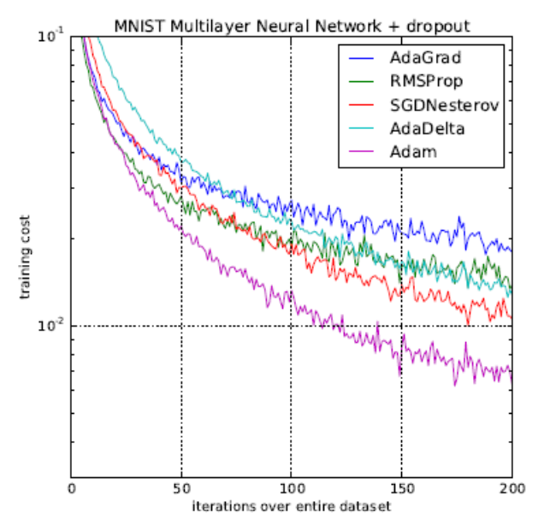
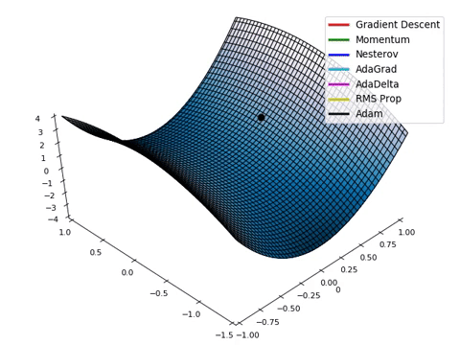
Performance Comparison of Optimizers
Notes:
https://mlfromscratch.com/optimizers-explained/#/

Slide 38
Useful reading links related to Optimizers
Various Optimization Algorithms For Training Neural Network
Optimizers Explained
5 Algorithms to train Neural Network
Training strategy
Stochastic vs Batch Gradient Descent
Notes:
https://medium.com/@kaitotally/adam-the-birthchild-of-adagrad-and-rmsprop-b5308b24b9cd

Slide 39
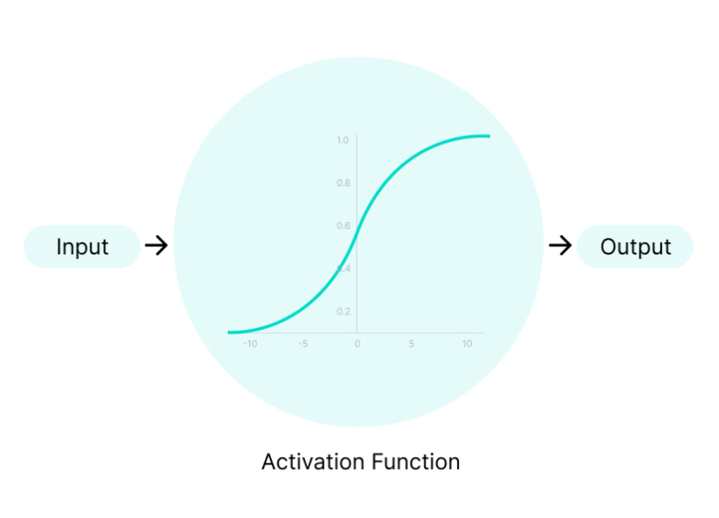
Hyperparameters - Activation Functions
Activation Functions decides, whether a neuron should be activated or not by calculating weighted sum and further adding bias with it.
The purpose of the activation function is to introduce non-linearity into the output of a neuron
Image Source

Slide 40
Types of Activation Functions in ANN
Sigmoid
Softmax
Linear
Tanh
ReLU
Leaky ReLU
SELU
Most used in Output Layer
Most used in Hidden Layer
Notes:
Useful Reading Links:
https://machinelearningmastery.com/choose-an-activation-function-for-deep-learning/#:~:text=An%20activation%20function%20in%20a,a%20layer%20of%20the%20network.

Slide 41
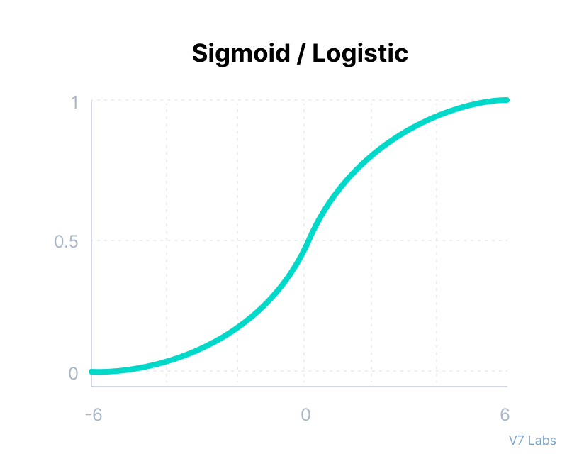
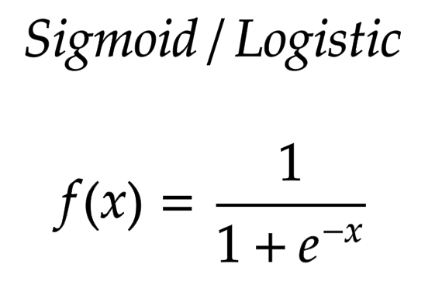
Sigmoid Activation Function
Output value range 0 to 1.
Mathematically compute as:
Limitations: Vanishing gradient

Slide 42
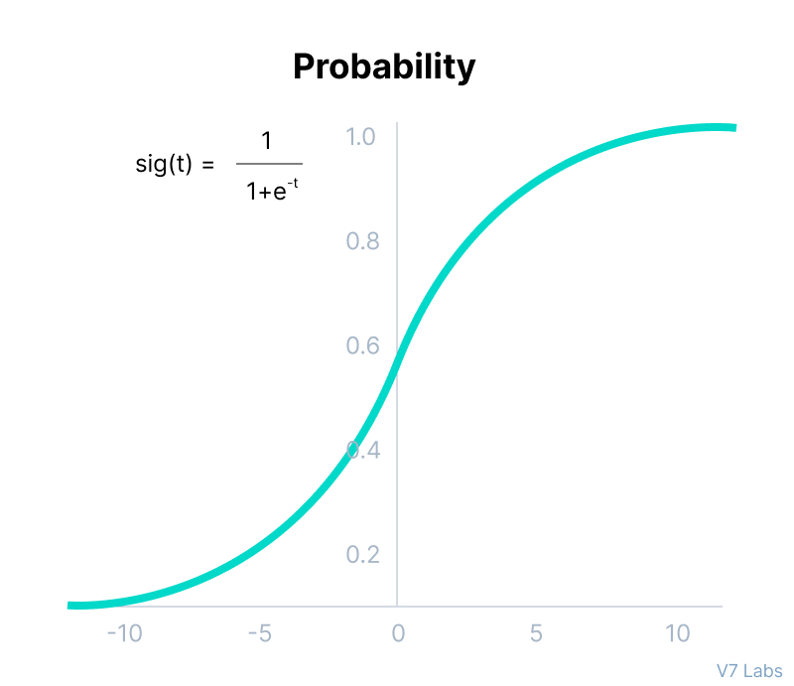
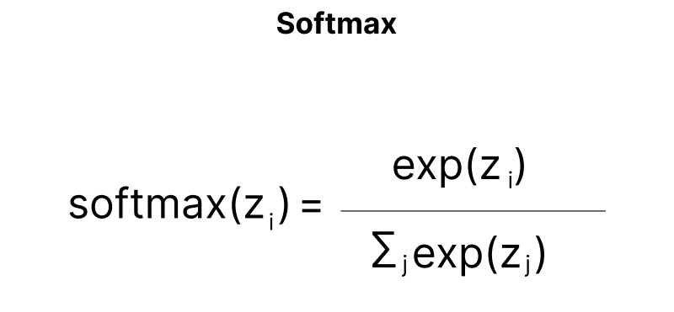
Softmax Activation Function
Softmax use probability distribution hence it most suitable use at the output layer for multi classification problem
Mathematically compute as:

Slide 43
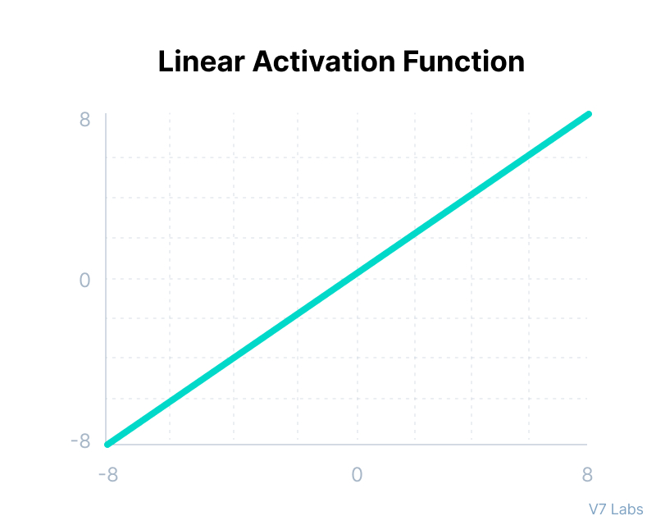
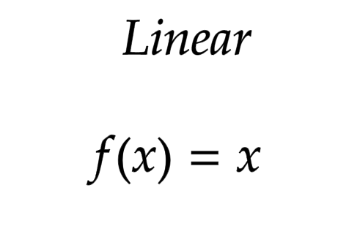
Linear Activation Function
The linear activation function, a.k.a "no activation," is where the activation is proportional to the input.
Mathematically compute as:

Slide 44
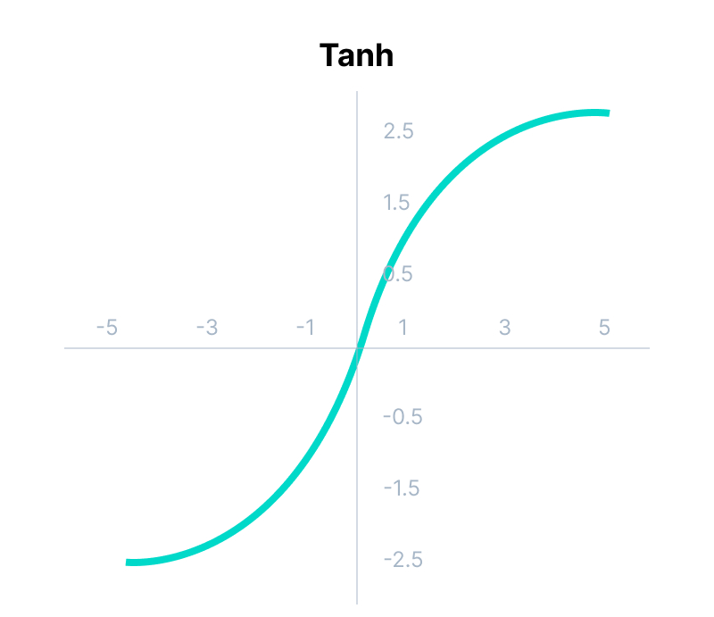
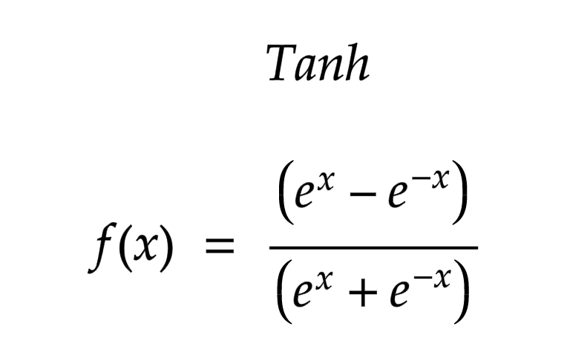
Tanh Activation Function
Output value range 0 to 1.
Can be compute as in figure below:
Limitations: Vanishing gradient

Slide 45
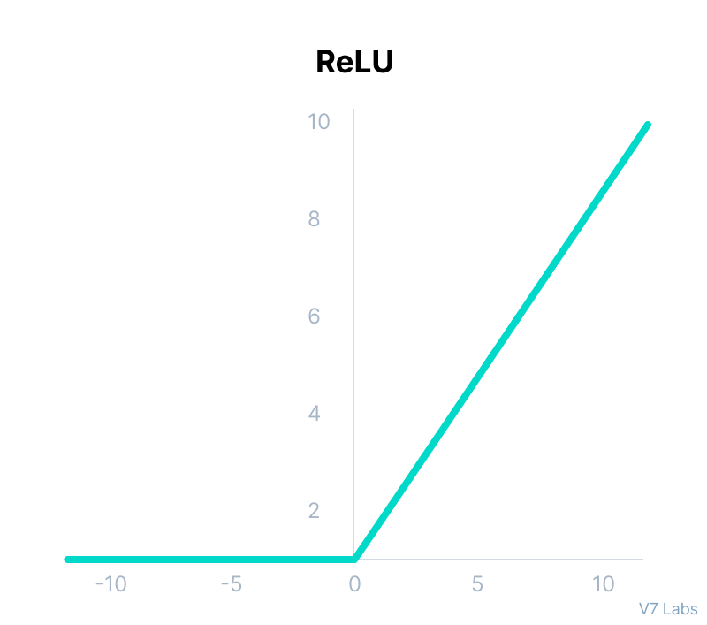
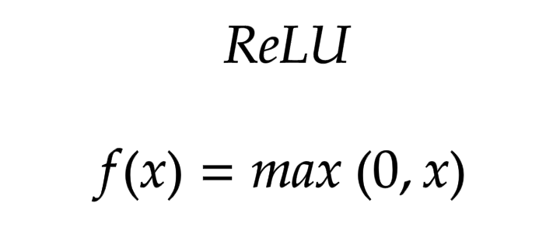
ReLU Activation Function
ReLU stands for Rectified Linear Unit
Mathematically computes as:
Limitations: Dying ReLU

Slide 46
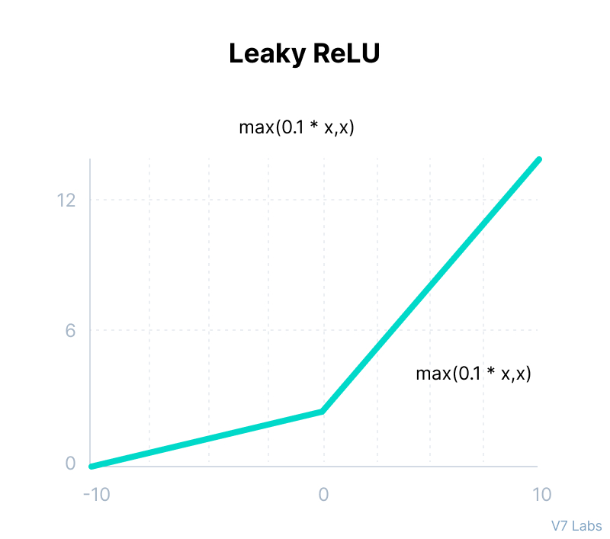
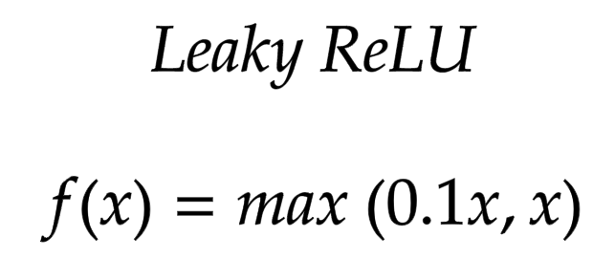
Leaky RELU
Improved version of ReLU function to solve the Dying ReLU problem as it has a small positive slope in the negative area.
Mathematically computes as:

Slide 47
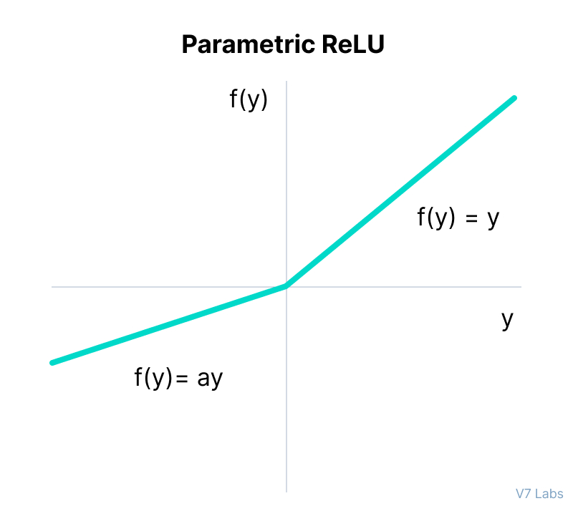
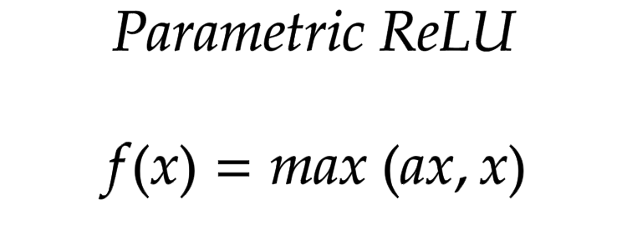
Parametric ReLU Function
Parametric ReLU is another variant of ReLU that aims to solve the problem of gradient’s becoming zero for the left half of the axis.
Parameterized ReLU function is used when the leaky ReLU function still fails at solving the problem of dead neurons
Mathematically compute as:

Slide 48
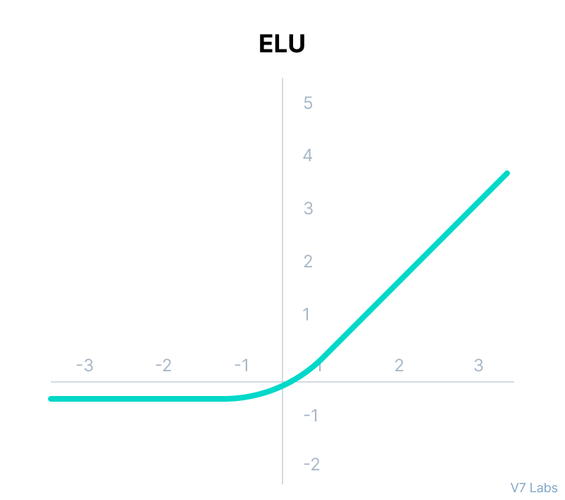
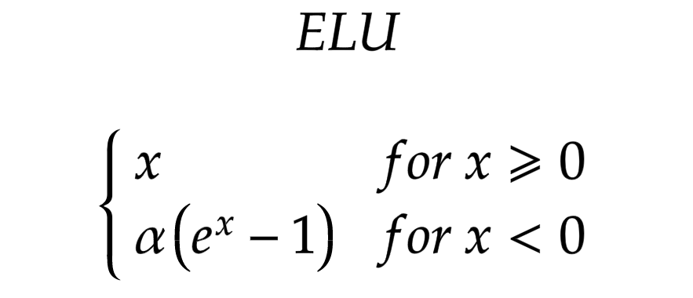
ELU
Exponential Linear Unit (ELU) also a variant of ReLU that modifies the slope of the negative part of the function.
Mathematically compute as:
Exploding gradient problem
Notes:
Useful reading link:
https://www.v7labs.com/blog/neural-networks-activation-functions#h4

Slide 49
Guide on how to choose the right Activation Function
For the output layer, identify your DL problem. Is it regression problem? Or classification problem?
Always use ReLU at Hidden Layer first and if the result does not provide optimum result you can change to other Activation Function
Sigmoid/Logistic and Tanh functions should not be used in hidden layers as they make the model more susceptible to problems during training (due to vanishing gradients problem).
ReLU is commonly use in Hidden layer for Convolutional Neural Network (CNN)
Tanh and/or Sigmoid is commonly used in Recurrent Neural Network

Slide 50
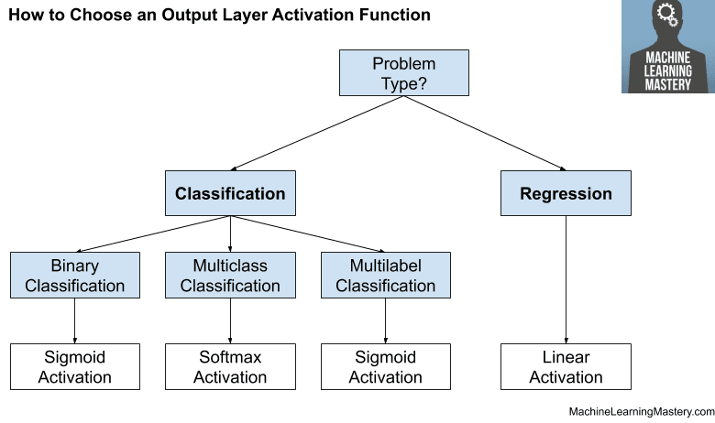
Image Source

Slide 51
Hyperparameters - Epochs
Number of epochs is the number of times the whole training data is shown to the network while training.
Increase the number of epochs until the validation accuracy starts decreasing even when training accuracy is increasing(overfitting).

Slide 52
Hyperparameters - Batch Size
Batch size is a hyperparameter that defines the number of samples to work through before updating the internal model parameters.
A good default for batch size might be 32. Also try 32, 64, 128, 256, and so on.

Slide 53
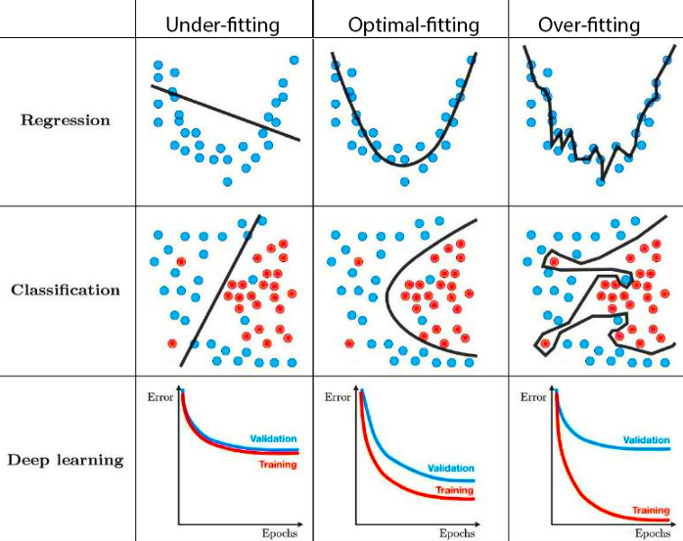
DL Model Performance - Learning Curve
We can detect issues in the behavior of a model by observing the evolution of a learning curve.
Notes:
https://machinelearningmastery.com/learning-curves-for-diagnosing-machine-learning-model-performance/

Slide 54
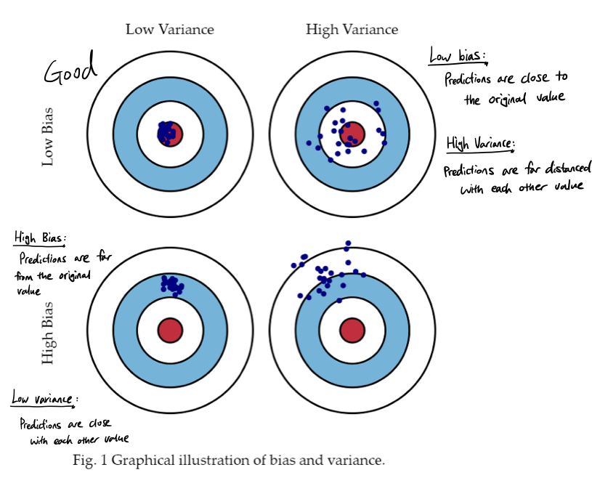
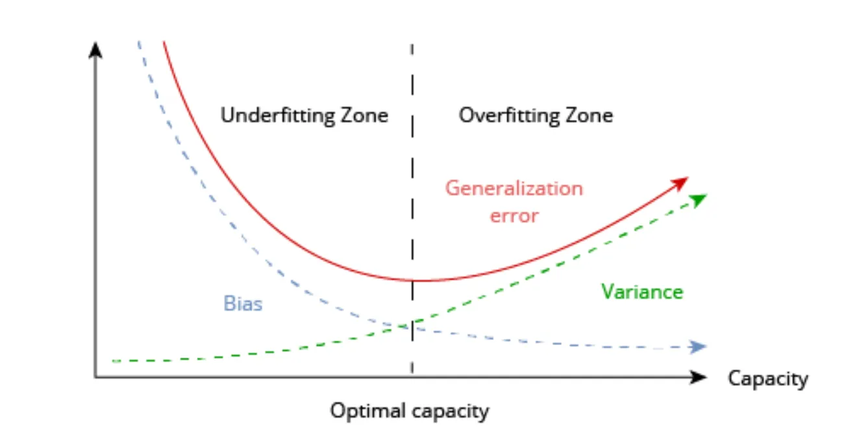
Bias and variance in ML/DL
Notes:
https://medium.com/@shiny_jay/ml-bias-variance-2164cb994842

Slide 55
Underfitting Model
Underfitting refers to a model that can neither model the training dataset nor generalize to new dataset.
An underfit model is not a suitable model and will be obvious as it will have poor performance on the training dataset.

Slide 56
Overfitting Model
Overfitting refers to the scenario where model cannot generalize or fit well on unseen dataset. A clear sign of overfitting is if its error on the testing or validation dataset is much greater than the error on training dataset.
Overfitting happens when a model learns the detail and noise in the training dataset to the extent that it negatively impacts the performance of the model on a new dataset. This means that the noise or random fluctuations in the training dataset is picked up and learned as concepts by the model. The problem is that these concepts do not apply to new datasets and negatively impact the model’s ability to generalize.

Slide 57
Underfitting Model - how to fix it?
Increase model complexity
Reduce Regularization
Add more features to the dataset

Slide 58
Overfitting Model - How to fix it?
Regularization
Dropout
Early Stopping
Cross-validation
Reading Link to understand Learning curve better

Slide 59
Regularization
One sign of overfitting is the high values of the weights. Thus, the idea behind norm regularization is to penalize weights with high values by adding a penalty term Ω(θ) to the loss function J(θ;X,y):
J(θ;X,y) = J(θ;X,y) + aΩ(θ)
Cost function = Loss + Regularization term
where:
θ denotes the trainable parameters,
X the input, and
y and target labels.
a is a hyperparameter that weights the contribution of the norm penalty, hence the effect of the regularization.
Two most popular methods of Regularization is L2 and L1.
Notes:
https://www.kdnuggets.com/2020/05/5-concepts-gradient-descent-cost-function.html

Slide 60
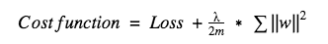
L2 Regularization
Here, lambda is the regularization parameter which is the sum of squares of all feature weights.
L2 technique forces the weight to reduce but never makes them zero.
Also referred to as ridge regularization, this technique performs best when all the input features influence the output, and all the weights are of almost equal size.

Slide 61
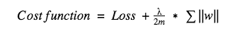
L1 Regularization
Unlike in the case of L2 regularization, where weights are never reduced to zero, in L1 the absolute value of the weights are penalised.
This technique is useful when the aim is to compress the model.
Also called Lasso regularization, in this technique, insignificant input features are assigned zero weight and useful features with non-zero.

Slide 62
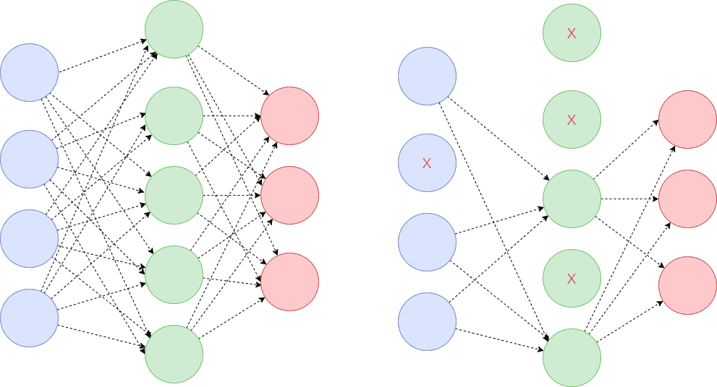
Dropout
Dropout means that during the training, randomly selected neurons are turned off or ‘dropped’ out. It means that they are temporarily obstructed from influencing or activating the downward neuron in a forward pass, and none of the weights updates is applied on the backward pass.

Slide 63
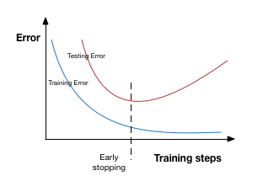
Early stopping
It is a kind of cross-validation strategy where one part of the training set is used as a validation set, and the performance of the model is gauged against this set. So if the performance on this validation set gets worse, the training on the model is immediately stopped.
Patience denotes the number of epochs with no further improvement after which the training will be stopped

Slide 64
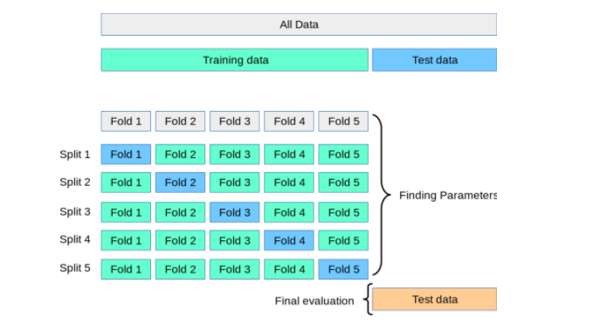
Cross-Validation
Cross-Validation is a resampling technique with the fundamental idea of splitting the dataset into 2 parts- training data and test data. Train data is used to train the model and the unseen test data is used for prediction. If the model performs well over the test data and gives good accuracy, it means the model hasn’t overfitted the training data and can be used for prediction.
Most common technique is k-fold cross validation

Slide 65
Important Key Takeaways…
Artificial Neural Network (ANN) is deep learning field and is built by the concept of Human Biological Neural Network
ANN has four main components which are Input, Nodes, Weights & Output. Input is the data feeding to the model & output is the result of node computation where the summation of weights*inputs and bias take place.
Activation function is responsible for the output of each nodes. Type of Activation function depends on the layers of nodes and DL problems.
Model parameters and hyperparameters are important concept in Deep Learning. Parameters is something internal to the data and cannot be changed by user while hyperparameters is user defined and usually defined at the start of the model training and can be fine-tune.
To train a model require learning strategy which can be implemented by monitoring the loss and choice of right optimizers
Loss metrics is used to evaluate the performance of the model while optimizers is responsible to adjust the parameters during model training
Model training performance is crucial and can be diagnosed with the Learning Curve where you can identify the whether the the model has Good Fit, Underfit or Overfit.
Based on the model performance, we can implement some techniques to overcome overfitting and underfitting of the model

Slide 66
Part III
Deep Learning Model & How it works

Slide 67
Multi-layer Perceptrons (MLP)
MLP a.k.a “Vanilla” Neural Network is the most common and basic neural network models in the field of deep learning.
A multi-layered perceptron consists of interconnected neurons (nodes) transferring information to each other like the human brain.
Each nodes has its own value and the connections between the layers are assigned with weights.
Example of MLP is Feedforward Neural Network.
The basic architecture of MLP is it has 3 main layers which are:-
Input Layer
Hidden Layer (may have more than one layer)
Output Layer
Notes:
https://www.educative.io/answers/what-is-a-multi-layered-perceptron

Slide 68
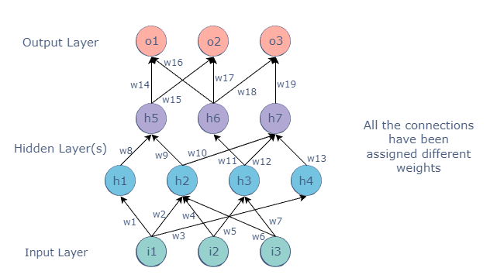
Multi-layer Perceptrons (MLP)
Why is it called Feedforward Neural Network?
Because the data transmitted from Input Layer to Output Layer in forward direction

Slide 69

Multi-layer Perceptrons (MLP)
Input Layer assigned with its own fixed value, while the values of all the other nodes (in Hidden Layer and Output Layer) are calculated through a mathematical function involving the weights and values of the layer before it.
For example, the value of the h5 node in figure above could be:

Slide 70

Multi-layer Perceptrons (MLP) - Backpropagation
is one of the method to optimize the weights of MLP using the outputs as inputs.
Initially, random weights will assigned to the connections.
These weights propagate forward to produce Outputs.
Naturally, predicted output would differ from the expected output.
The difference of these two values is called the error/loss function.
The error is sending back through backward propagation and automatically alter the weights.
The networks will kept iterating and adjusting its weights forward and backward until the predicted output is closer to the actual output.

Slide 71
Recurrent Neural Network (RNN)
While Feedforward Neural Network (FFNN) is great solution for regression and classification problems, it is not very great to handle sequential data.
This is because sequential data posses historical data that need to be remembered but FFNW do not have the capability to hold memory of the past data.
RNN is introduced to overcome Feedforward Neural Network limitations which are:-
Cannot handle sequential data
Considers only the current input
Cannot memorize previous inputs
RNN can handle sequential data, accepting the current input data, and previously received inputs. RNNs can memorize previous inputs due to their internal memory.

Slide 72

Recurrent Neural Network (RNN) - Model Architecture
RNN works on the principle of saving the output of a particular layer and feeding this back to the input in order to predict the output of the layer.
The nodes in each layers of the neural network are compressed to form a single layer of recurrent neural networks.

Slide 73

Recurrent Neural Network (RNN) - Working Mechanisms
Unrolling the RNN. Crucial concept! RNN only consists of single node in each layer which loop through the hidden layer

Slide 74

Recurrent Neural Network (RNN) - Working Mechanisms
RNN processes the sequence of vectors one by one.
While processing, it passes the previous hidden state to the next step of the sequence.
The hidden state acts as the neural networks memory which hold information on previous data the network has seen before.
Notes:
https://towardsdatascience.com/illustrated-guide-to-lstms-and-gru-s-a-step-by-step-explanation-44e9eb85bf21

Slide 75

Recurrent Neural Network (RNN) - Working Mechanisms
The Input and previous hidden state are combined to form a vector.
This vector contains information on the current input and previous inputs
The vector goes through the tanh activation, and the output is the new hidden state, or the memory of the network.

Slide 76


Recurrent Neural Network (RNN) - Working Mechanisms
The tanh activation is used to help regulate the values flowing through the network between -1 and 1.

Slide 77




Types of Recurrent Neural Network (RNN)

Slide 78
RNN Applications
Image Captioning - RNNs are used to caption an image by analyzing the activities present.
Time Series Prediction - Any time series problem, like predicting the prices of stocks in a particular month, can be solved using an RNN.
Natural Language Processing - Text mining and Sentiment analysis can be carried out using an RNN for Natural Language Processing (NLP).
Machine Translation - Given an input in one language, RNNs can be used to translate the input into different languages as output

Slide 79
Recurrent Neural Network (RNN) - Problems
Vanishing Gradient problems
RNNs suffer from the problem of vanishing gradients.
The gradients carry information used in the RNN, and when the gradient becomes too small, the parameter updates become insignificant.
This makes the learning of long data sequences difficult.
Exploding Gradient problems
While training a neural network, if the slope tends to grow exponentially instead of decaying, this is called an Exploding Gradient.
This problem arises when large error gradients accumulate, resulting in very large updates to the neural network model weights during the training process.
Long training time, poor performance, and bad accuracy are the major issues in gradient problems.
Notes:
Useful reading link: https://www.nickmccullum.com/python-deep-learning/vanishing-gradient-problem/

Slide 80

In RNN information from previous time points is used as input for the next time points.
Cost function/error (Et) is calculated at each time point.
As the model calculated the Et, it needs to backpropagate through the network in order to update its weight
In RNN, the calculated errors is send to update the weights by propagating all the way back through time to the neurons that participated in the calculation of the output.
The problem relates to updating wrec (weight recurring) – the weight that is used to connect the hidden layers to themselves in the unrolled temporal loop.

Slide 81

Notes:
Useful reading link:
https://www.superdatascience.com/blogs/recurrent-neural-networks-rnn-the-vanishing-gradient-problem

Slide 82
Vanishing Gradient problems - Explanation
Essentially, to get from xt-3 to xt-2 we multiply xt-3 by wrec.
Then, to get from xt-2 to xt-1 we again multiply xt-2 by wrec.
So, we multiply with the same exact weight multiple times, and this is where the problem arises: when you multiply something by a small number, your value decreases very quickly.
As we all know that Gradient descent (GD) is an iterative first-order optimisation algorithm used to find a local minimum/maximum of a given function. This method is commonly used in machine learning (ML) and deep learning(DL) to minimise a cost/loss function.
The lower the gradient is, the harder it is for the network to update the weights and the longer it takes to get to the final result.
To sum up, if wrec is small, you have vanishing gradient problem, and if wrec is large, you have exploding gradient problem.
Notes:
Gradient descent explanation:
https://towardsdatascience.com/gradient-descent-algorithm-a-deep-dive-cf04e8115f21#:~:text=Gradient%20descent%20(GD)%20is%20an,e.g.%20in%20a%20linear%20regression).

Slide 83

Long Short Term Memory (LSTM) - Working Mechanism
Notation
ct-1 stands for the input from a memory cell in time point t
xt is an input in time point t;
ht is an output in time point t that goes to both the output layer and the hidden layer in the next time point.
Thus, every block has three inputs (xt, ht-1, and ct-1) and two outputs (ht and ct).
Notes:
https://towardsdatascience.com/illustrated-guide-to-lstms-and-gru-s-a-step-by-step-explanation-44e9eb85bf21

Slide 84




Long Short Term Memory (LSTM) - Working Mechanism
Copy: the information is copied and goes into two different directions, as for example, at the right bottom of the scheme, where output information is copied in order to arrive at two different layers ht.
Vector transfer: any line on the scheme is a vector.
Concatenate: two lines combining into one, as for example, the vectors from ht-1 and xt. You can imagine this like two pipes running in parallel.
Neural Network Layer: layer operations, where you’ve got layer coming in and layer coming out

Slide 85

Long Short Term Memory (LSTM) - Working Mechanism
Pointwise operation: there are five pointwise operations on the scheme and they are of three types:
“x” or valves (forget valve, memory valve, and output valve) – points on the scheme, where you can open your pipeline for the flow, close it or open to some extent. For instance, forget valve at the top right of the above scheme is controlled by the layer operation s. Based on a decision of this sigmoid activation function (ranging from 0 to 1), the valve will be closed, open or closed to some extent. If it’s open, memory flows freely from ct-1 to ct. If it’s closed, then memory is cut off, and probably new memory will be added further in the pipeline, where another pointwise operation is depicted.
“+” – t-shaped joint, where you have memory going through and you can add additional memory if the memory valve below this joint is open.
“tanh” – responsible for transforming the value to be within the range from -1 to 1 (required due to certain mathematical considerations).

Slide 86

Long Short Term Memory (LSTM) - Working Mechanism
Step by step:
Incoming new value xt and value from the previous node ht-1 (input)
These values are combined together and go through the sigmoid activation function, where it is decided if the forget valve should be open, closed or open to some extent.
The same values go in parallel through another layer operation “tanh”, where it is decided what value we’re going to pass to the memory pipeline, and also sigmoid layer operation, where it is decided, if that value is going to be passed to the memory pipeline and to what extent.
Then, we have a memory flowing through the top pipeline. If we have forget valve open and memory valve closed then the memory will not change. Otherwise, if we have forget valve closed and memory valve open, the memory will be updated completely.
Finally, we’ve got xt and ht-1 combined to decide what part of the memory pipeline is going to become the output of this module.

Slide 87

Convolutional Neural Network (CNN)
Convolutional Neural Network is a specialized neural network designed for visual data, such as images & videos. But CNN also work well for non-image data (especially in NLP & text classification).
Its concept is similar to that of a vanilla neural network (multilayer perceptron) – It follows the same general principle of forwarding & backward propagation

Slide 88

Convolution Layer
Convolution is the summation of the element-wise product of 2 matrices.
consider an image ‘X’ & a filter ‘Y’ (More about filter will be covered later). Both X & Y, are matrices (image X is being expressed in the state of pixels). When we convolve the image ‘X’ using filter ‘Y’, we produce the output in a matrix, say’ Z’.
Finally, we compute the sum of all the elements in ‘Z’ to get a scalar number (3+4+0+6+0+0+0+45+2 = 60)
In short convolution layer shrink the size of the input image
X
Y
Z

Slide 89


Slide 90
Filter/Kernel
Filter/kernel is like a scanner that move through the input then performed the convolution to give the output

Slide 91
Padding
Notes:
https://github.com/vdumoulin/conv_arithmetic

Slide 92
Pooling Layer
Pooling is a down-sampling operation that reduces the dimensionality of the feature map. The rectified feature map now goes through a pooling layer to generate a pooled feature map.

Slide 93
Key Takeaways…
The most basic deep learning model is the Multi-Layer Perceptrons (MLP)
MLP has three main layers which are Input Layer, Hidden Layer (may have more than one layer) and Output Layer which propagate in forward direction and adjusting the weights by backpropagation to minimize the cost metrics
Recurrent Neural Network is introduced to handle sequential data since FFNW do not have the ability to hold memory on the historical data
RNN suffers vanishing gradient and exploding gradient which LSTM is introduced to overcome the RNN limitation

Slide 94
References
A comprehensive beginner’s guide to create a Time Series Forecast (with Codes in Python and R)
Comparing ARIMA Model and LSTM RNN Model in Time-Series Forecasting
Deep Learning for Time Series Forecasting Predict the Future with MLPs, CNNs and LSTMs in Python (Jason Brownlee)
11 Classical Time Series Forecasting Methods in Python (Cheat Sheet)
Time Series Prediction: How Is It Different From Other Machine Learning?
Deep Learning Book

